Slide 1
MACHINE LEARNING
~ BY Sai Gawand

Slide 2
ARTIFICIAL INTELLIGENCE
Create intelligent machines that can stimulate human thinking capability and behaviors.
Stimulating human intelligence into a machine.

Slide 3
MACHINE LEARNING
Application of artificial intelligence that allows machine to learn from data being programmed.

Slide 4
SUPERVISED LEARNING, UNSUPERVISED LEARNING, REINFORCEMENT LEARNING
Supervised Learning: Learn from someone or something
Someone teach and we learn.
Features and Labels
Regression and Classification
Unsupervised Learning: Learning on own
Learning on own by experience
Only features
Clustering and Association
Reinforcement Learning: Learning by Rewards and Penalties

Slide 5
MACHINE LEARNING ALGORITHMS
Linear Regression: Relation between dependent and independent variables.
Decision Tree: Decision made by single person.
Random Forest: Decision made by majority.
K Nearest Neighbor: NEAREST neighbor having similar characteristics.
Support Vector Machine: Analyse data for classification.
NAIVE Base Algorithm: Collection of classification algorithms based on Bayes’ Theorem.

Slide 6
FEATURES LABELS AND MODELS
Features: Input given in the machine learning algorithm.
Labels: Output in the machine learning algorithm.
Models: The program or function obtained in Machine Learning.

Slide 7
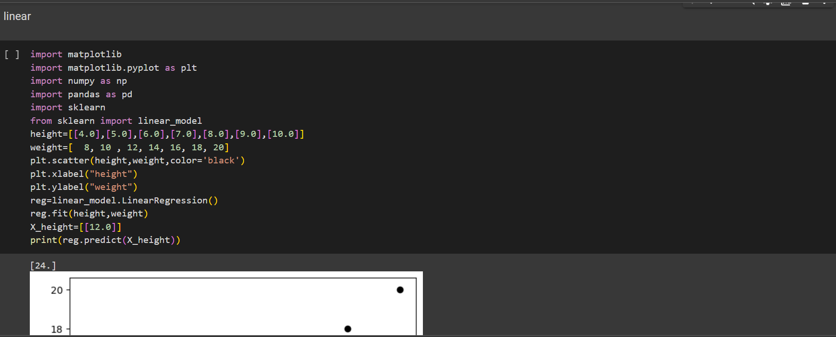
Linear regression

Slide 8
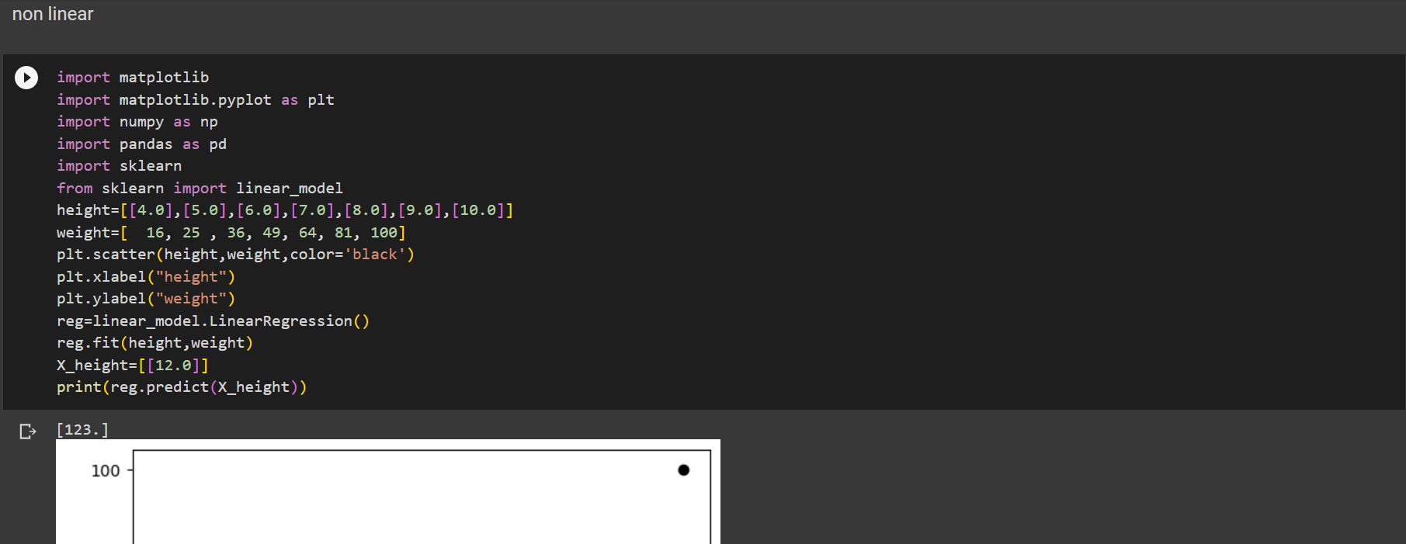
Non Linear

Slide 9
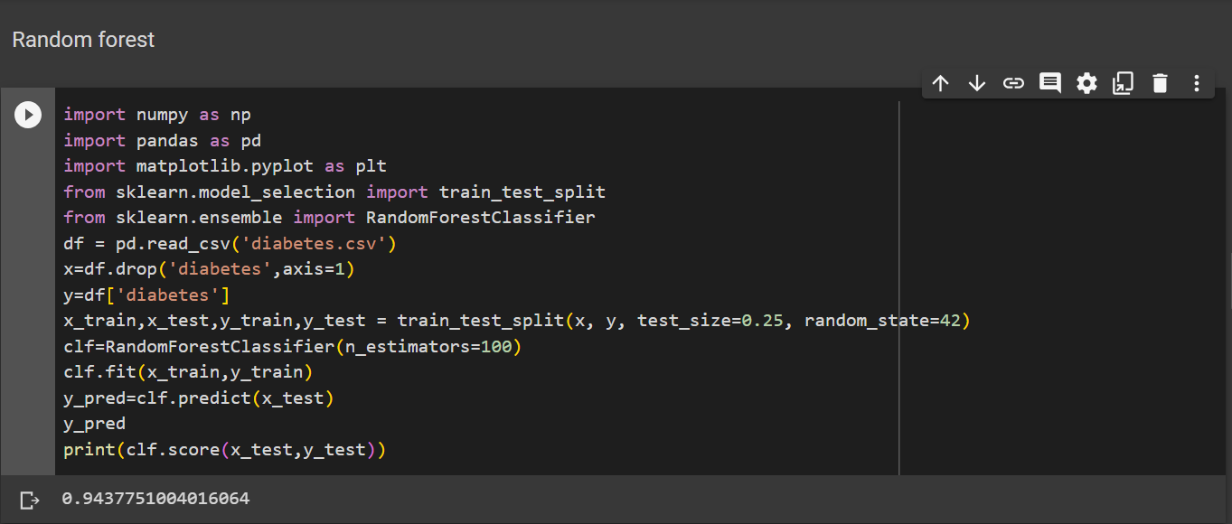
Random Forest

Slide 10
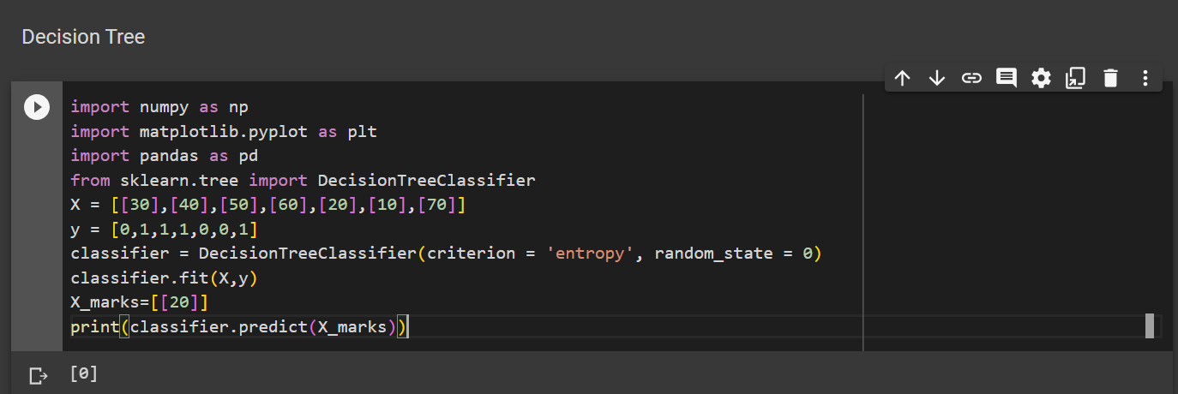
Decision Tree

Slide 11
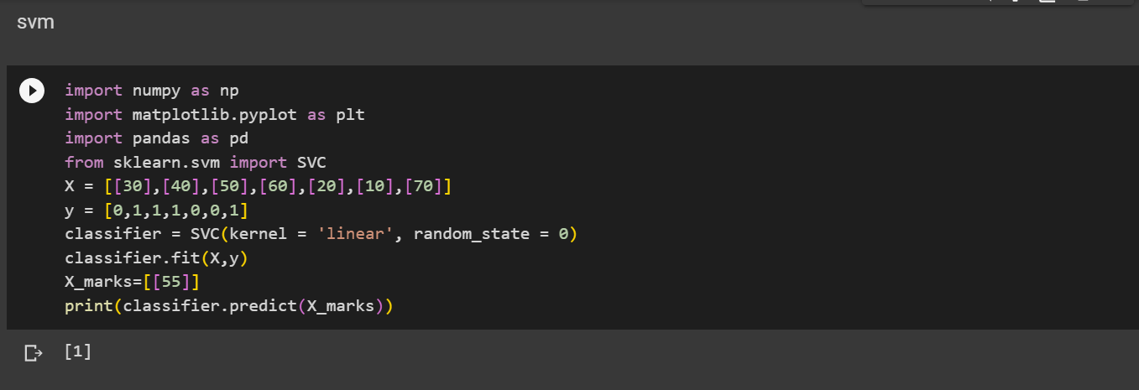
SVM (Support Vector Mission)

Slide 12
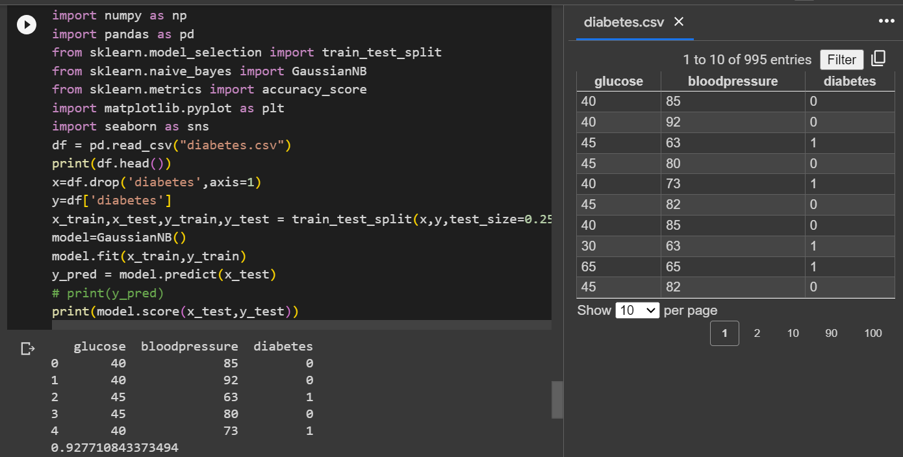
Naive Bayes

Slide 13
THANK YOU
~By Sai Gawand

